Slide 1




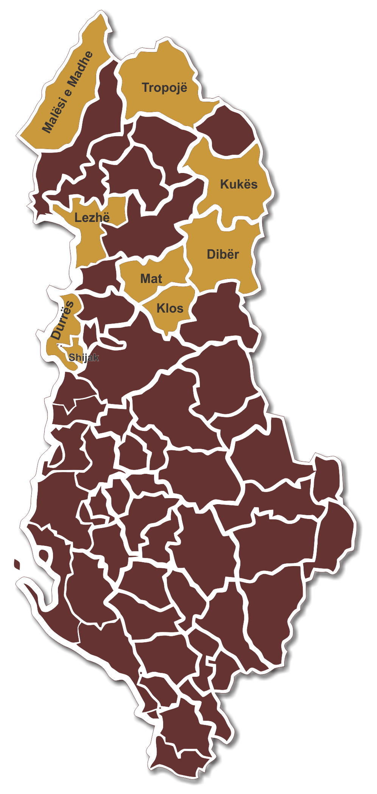

Functional Areas Programme
Stefan Pfäffli (dldp/HSLU)
Blendi Bushati (dldp)

Slide 2

Functional Areas Programme
The Principle of Functionality in Territorial Policy
Territories are often fragmented by historical boundaries.
  Disadvantages:
    Inefficiencies (fixed costs to high, spill-over effects, coordination problems especially in case of network-infrastructure...)
    Development potential of areas not fully utilized
    Positioning of areas too weak
  Need for territorial reform TAR (mergers) or horizontal collaboration
Programme for Local Development and Decentralization (dldp) | www.dldp.al | www.km.dldp.al | dldp@helvetas.org

Slide 3
Functional Areas Programme
The Principle of Functionality in Territorial Policy
Principle of Functionality used for TAR
  Economic and social activities take place in space (areas) reaching beyond historical borders. Areas with intense socio-economic activities are considered as functional areas.
  When TAR takes place in order to overcome the disadvantages of fragmentation, it should make sure that administrative borders better harmonize with functional areas.
  Principle used for TR in Switzerland, Germany, Ireland, Spain,... Promoted by OECD and EU (mainly for urban areas).
Programme for Local Development and Decentralization (dldp) | www.dldp.al | www.km.dldp.al | dldp@helvetas.org

Slide 4
Functional Areas Programme
Where Does the FAP Idea Come From?
Functional areas have a potential for development, but
  Policy measures needed to make it happen
  Area-wide approach (coordination / bundling of intervention)
  Integrated policy approach reaching beyond single sector policies
  (Joint) decision making and implementation body needed
Programme for Local Development and Decentralization (dldp) | www.dldp.al | www.km.dldp.al | dldp@helvetas.org

Slide 5
Functional Areas Programme
Where Does the FAP Idea Come From?
2. Swiss Agglomeration Programme AP as role model
  Agglomeration = urban functional area, often fragmented into urban city centre and surrounding municipalities
  Traditionally, horizontal collaboration frequent but single- function oriented
  AP for a better development and positioning of agglomerations: Matching grants of Central Government for the development of agglomerations under condition:
    Integrated, agglomeration-wide development strategy
    Projects identified, costed and feasibility checked
    Decision-making and implementation body in place
Programme for Local Development and Decentralization (dldp) | www.dldp.al | www.km.dldp.al | dldp@helvetas.org

Slide 6
Functional Areas Programme
 | FAP | SAP
Territory | FA | Existing LGU
Scope | Narrower focus: regional develop-ment and local service delivery gaps and modalities | Broader focus: covering all LGU-functions
Time horizon | Transition period, ~4 years | ~10 Years for on-going (local) governments
Approach | Expert-based, less participative | Stakeholder- based, more participative
Implementation | Functional Area Methodology | SDPeMTBP followed up by Urban Planning
Responsible institutions: | LGU-s and Agency for Territorial Reform | LGU-s and MUD/MoF and DSFAP
Programme for Local Development and Decentralization (dldp) | www.dldp.al | www.km.dldp.al | dldp@helvetas.org

Slide 7
Functional Areas Programme
Implementation: SDPeMTBP also for FAP?
SDP-e-MTBP
  SDP: formally adopted by Council
  Implemented through MTBP (with three year perspective) and integrated in programme structure
  Fînancial planning and financial feasibility check facilitated
  by FPT
Time too short in fall 2015 for implementation of FAP via eMTBP
  FAP not yet formally adoted when budeting process starts
  FAP data for bigger municipality might not be existing/ready
  Programme structure for MTBP might not yet be existing
  FAPeMTBP not a realistic scenario for 2015
Ongoing national reforms and legal changes obstacle for strategic thinking
  Organic law and Law on local finances
  Urban planning and regional development schemes
  Sectorial reforms (water, waste etc.)
Programme for Local Development and Decentralization (dldp) | www.dldp.al | www.km.dldp.al | dldp@helvetas.org

Slide 8
Functional Areas Programme
Adoption & Implementation of FAP – a More Realistic Scenario
(Assumptions)
  In fall 2015, Council and administration have to guarantee the functioning of the new organization and of service delivery
  Concentration on basic PFM processes needed (annual budget for 2016, no MTBP for 2016)
  FAP needs to be formally adopted by new Council when the Council is ready for it (spring 2016), if needed after necessary adjustments made
  Identified projects through FAP (priority highly ranked ones and QSP) should enter in annual budget for 2016 as far as possible
  First new MTBP will be prepared for 2017-2019 in 2016
  Annual monitoring of FAP implementation via MTBP
  New SDP will be elaborated in 2020 only under new local government although certain LGU-s might advance
Programme for Local Development and Decentralization (dldp) | www.dldp.al | www.km.dldp.al | dldp@helvetas.org

Slide 9
Functional Areas Programme
Adoption & Implementation of FAP – a More Realistic Scenario
(Simplified sequencing)
2015 I Forum approves FAP
2015 III GSB screens FAP and identifies/confirms FAP Projects
2015 IV Annual budget for 2016 includes FAP Projects as far as possible; no MTBP for 2016-18
2016 I Financial Commission discusses FAP
2016 II Council approves (adjusted) FAP
2016 III Preparation of MTBP 2017-19, ceilings based on FAP; First year = annual budget 2017
2016 I-IV Implementation of annual budget 2016 incl. FAP Projects
2017 II Monitoring report on implementation of FAP Projects
2017 III Preparation of MTBP 2018-20, ceilings based on FAP; First year = annual budget 2018
2017 I-IV Implementation of annual budget 2017 incl. LEDP & SIP
2020 I Kick of for elaboration of SDP
Programme for Local Development and Decentralization (dldp) | www.dldp.al | www.km.dldp.al | dldp@helvetas.org

Slide 10
Functional Areas Programme
FAP: The product – General overview
Functional Area Analysis
  Economy
  Public services
  Local Government
Functional Area Development Programme
  Priority projects:
    Economic Development
    Public services improvement
    Quick Start Projects
  Implementation structure
Programme for Local Development and Decentralization (dldp) | www.dldp.al | www.km.dldp.al | dldp@helvetas.org

Slide 11
Functional Areas Programme
FAP: The product – The Functional Area Analysis
Economy of the functional area
including two or three more in-depth analysis of the identified main economic sectors in the Functional Area.
Mapping of the services
provided in the FA with the focus on the most commonly provided services but of course open to further analysis of any other function deemed relevant to that particular Functional Area.
Local Government Analysis
providing the analysis of the local government organization; human resources etc.
Programme for Local Development and Decentralization (dldp) | www.dldp.al | www.km.dldp.al | dldp@helvetas.org

Slide 12
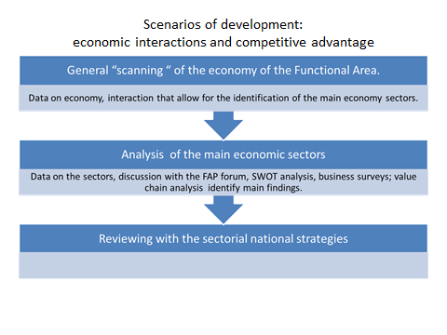
Functional Areas Programme
FAP: The product – The Economic Analysis
Programme for Local Development and Decentralization (dldp) | www.dldp.al | www.km.dldp.al | dldp@helvetas.org

Slide 13
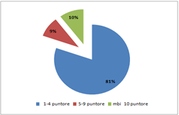
Illustration economic scanning
GDP of the Kukes region by sectors/ fluctuation over the years
Structure of enterprises by number of employees in the FA Kukes
Structure of enterprises by sector in the FA Kukes
Key findings: Agriculture important, construction shrinking, industry growing, micro enteprises dominate trade and services.

Slide 14
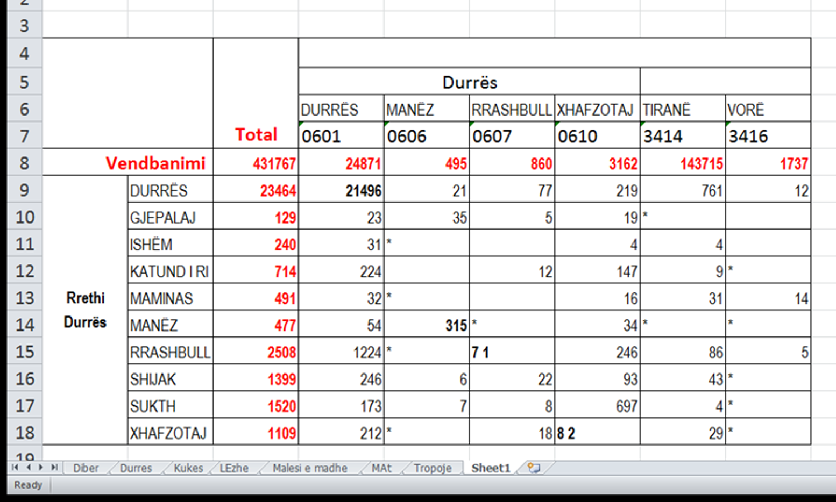
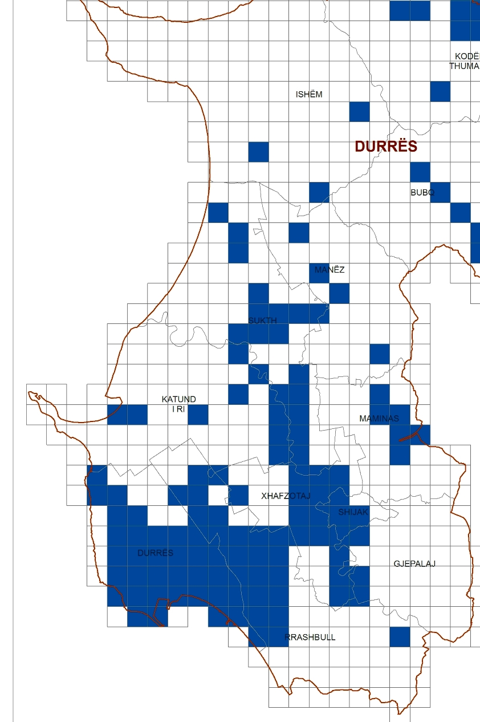
Urban density and continuation, employment centers, commuting
Key findings: Densely inhabited area across administrative borders, frequent interaction to and form Durres, important linkages to Shijak (Xhafzotaj) and Tirane).

Slide 15
Illustration economic analysis – subsectors
Diber FA % of the product going to the market (per type of product)
Diber FA Average net income per per ha of each product
Key recommendation: Increase the cultivation of products going to the markets, especially fruit trees.

Slide 16
Functional Areas Programme
FAP: The product – Mapping of the public services
General Scanning of the Service at the Local Level
Service coverage, service quality, existing infrastructure in all the LGU-s
Management and financing of the service
How is the service provided in different parts of the territory
Recommendations for the integration of the service in the new merged LGU
Programme for Local Development and Decentralization (dldp) | www.dldp.al | www.km.dldp.al | dldp@helvetas.org

Slide 17
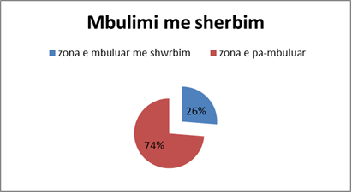
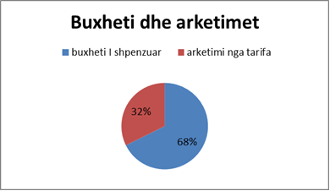
Functional Areas Programme
Coverage of the population with the waste collection service
Cost recovery of the waste collection
from the tariffs
Key findings: 2/3 of the territory of the FA not covered at all with the waste service, few LGUs collect the waste tariff.
Programme for Local Development and Decentralization (dldp) | www.dldp.al | www.km.dldp.al | dldp@helvetas.org

Slide 18
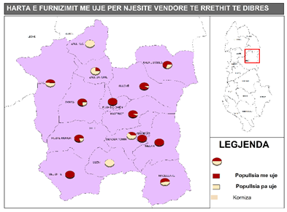
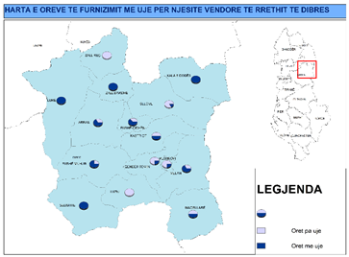
Functional Areas Programme
Coverage of the population with piped water supply per each current LGU
Hours of supply per each LGU
Key findings: Some settlements do not have a water supply network, hours of supply differ across Lgus.
Programme for Local Development and Decentralization (dldp) | www.dldp.al | www.km.dldp.al | dldp@helvetas.org

Slide 19
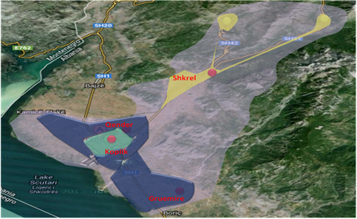
Functional Areas Programme
Key recommendations: Integrate the waste collection and depositing services, find alternative solutions for very remote mountainous areas.
Programme for Local Development and Decentralization (dldp) | www.dldp.al | www.km.dldp.al | dldp@helvetas.org

Slide 20
Functional Areas Programme
The development programme of the FA
Functional area projects on the economic development and integration as well as improvement of public services, aiming to strengthen the internal cohesion of the FA as well as to make use of the expected benefits of delivering joint services.
Structures and processes of the implementation of the FAP including recommendations for the organizational setup of the new LGU.
Programme for Local Development and Decentralization (dldp) | www.dldp.al | www.km.dldp.al | dldp@helvetas.org

Slide 21
Functional Areas Programme
  FAP: The product – The development programme of the functional area
  The economic development projects.
  Focus on the priority economy sectors as identified in the FAP; impact on the private sector development, public private partnerships, strengthening of the SME-s, improvement of the business climate, assistance to the business start ups Marketing of the territory etc.
The public service improvement projects.
Projects that aim to improve public services under the competency of the LGUs in the wider functional area identifying actions that will deliver better services to the FA citizens
The Quick start projects
Projects typically deriving form the recommendations of the governance analysis and can quickly mobilize to improve (especially) administrative services in the new LGU.
Programme for Local Development and Decentralization (dldp) | www.dldp.al | www.km.dldp.al | dldp@helvetas.org

Slide 22
Functional Areas Programme
CLEAN DIBRA
Project type: Public Services
Location: FA Diber, all the administrative units
Total project cost (EUR) 420,000
Objective : Improvement of the waste management system in the Dibra FA, in order to cover with the waste collection services the Peshkopi town and in all the 141 villages within 2017.
THE WINE ROUTE Itinerary
Project type: Economic development/social cohesion
Location: FA Durres,Manez and Sukth
Total project cost (EUR) 21,000
Objective :Promotion of the homemade products from farms and wineyards (i.e wine and cheese) in order to develop the internal tourism in the area (complementary to the coastal one)
Programme for Local Development and Decentralization (dldp) | www.dldp.al | www.km.dldp.al | dldp@helvetas.org

Slide 23
Functional Areas Programme
  FAP: The product – Structure and processes
The steps for the new LGU setup recommendations:
Analyses of the organograms of the current LGUs
Management of the public services in the current LGUs and the differences noted.
Consultation process with the LGUs administrations
Identification of recommendations for the new organizational structure:
  Creation, merger, integration of the departments in the new LGU to respond to the functions
  Integration of the public services provision in the new LGU
  Recommendations for the human resources/ skills needed for the employees.
Programme for Local Development and Decentralization (dldp) | www.dldp.al | www.km.dldp.al | dldp@helvetas.org

Slide 24
Functional Areas Programme
FAP: The process – Key steps
Discussion and agreement of the idea with the political actors
The Functional Area Analysis
Identification and preparation of key projects
Recommendations on the new LGU organization
Communication strategy
Finalization and approval
Programme for Local Development and Decentralization (dldp) | www.dldp.al | www.km.dldp.al | dldp@helvetas.org

Slide 25
Functional Areas Programme
FAP: The process – Key actors
The new LGU.
Mayor, Council the owners of the FAP
The FAP forum :
Ad hoc forum for the FAP preparation; brings together key actors local politicians, key interest groups, business civil society, territory representation, deconcentrated agencies, universities etc.
The general public of the FA can be reached via media campaigns, public exhibitions etc.
The external expertise a group of external experts specialized in key areas needed for the analyses and project preparation.
Programme for Local Development and Decentralization (dldp) | www.dldp.al | www.km.dldp.al | dldp@helvetas.org

Slide 26
Functional Areas Programme
FAP: Methodological guidance
Desk work suggestions for earlier work
Databases , studies that can be used
Methodological instruments proposed to be used for further qualitative data collection
Detailed guided questionnaires for public services
Templates for project preparation
ToR : Expertise and skills needed.
Programme for Local Development and Decentralization (dldp) | www.dldp.al | www.km.dldp.al | dldp@helvetas.org

Slide 27
Functional Areas Programme
Thank you!
Programi për Decentralizim dhe Zhvillim Lokal (dldp) | www.dldp.al | www.km.dldp.al | dldp@helvetas.org
Programme for Local Development and Decentralization (dldp) www.dldp.al | www.km.dldp.al | dldp@helvetas.org

